Slide 1
Basic Measurement Theory
Measurement
The art or process of determining the amount, quantity, degree, or capacity by comparison with accepted standards of the system of units employed.
is defined as the process of comparison of an unknown quantity with a known or standard quantity.

Slide 2
NEED OF MEASUREMENT
Establish standard
Interchangeability
Customer Satisfaction
Validate the design
Physical parameter into meaningful number
True dimension
Evaluate the Performance

Slide 3
METHODS OF MEASUREMENT
Direct method
Indirect method
Comparative method
Coincidence method
Contact method
Deflection method
Complementary method

Slide 4
DIRECT METHOD
Measurements are directly obtained
Ex: Vernier Caliper, Scales
INDIRECT METHOD
Obtained by measuring other quantities
Ex: Weight = Length x Breadth x Height x Density

Slide 5
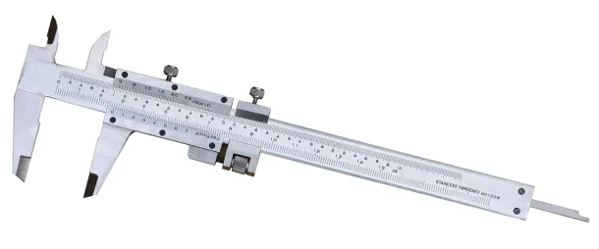
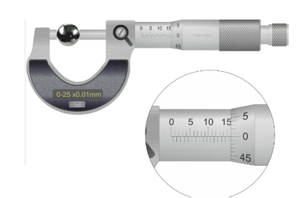
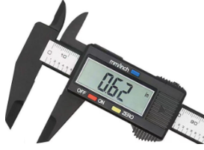
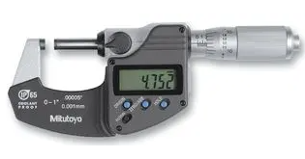

Analog and Digital
Vernier Caliper
Analog and Digital Micrometer

Slide 6
COMPARATIVE METHOD
It’s compared with other known value
Ex: Comparators
COINCIDENCE METHOD
Measurements coincide with certain lines and signals

Slide 7
FUNDAMENTAL METHOD
Measuring a quantity directly in related with the definition of that quantity
CONTACT METHOD
Measuring tip touch the surface area
Ex: Sensors

Slide 8
COMPLEMENTARY METHOD
The value of quantity to be measured is combined with known value of the same quantity
Ex: Volume determination by liquid displacement

Slide 9
Units and standards
SI: fundamental Units
Physical Quantity Unit Name Symbol
Length meter mMass kilogram kgtime second selectric current ampere Atemperature Kelvin Kamount of substance mole molluminous intensity candela cd
DEFLECTION METHOD
The value to be measured is directly indicated by a deflection of pointer
Ex: Pressure Measurement

Slide 10
Units and Standards (SI: Fundamental Units)
Physical Quantity | Unit Name | Symbol
Length | meter | m
Mass | kilogram | kg
Time | seconds | s
Electric Current | ampere | A
Temperature | Kelvin | K
Luminous Intensity | candela | Cd

Slide 11
Units and Standards (SI: Derived Units)
Physical Quantity | Unit Name | Symbol
Area | square meter | m²
Volume | cubic meter | m³
Speed | meter per second | m/s
Acceleration | meter per second squared | m/s²
Force | Newton | N
Pressure | Pascal | P

Slide 12
Units and Standards (SI: Derived Units)
Physical Quantity | Unit Name | Symbol
Energy, Work | Joule | J
Electromotive Force | Volt | V
Quantity of charge | Coulomb | C
Electrical Resistance | Ohm | Ω
Capacitance | Farad | F
Inductance | Henry | H

Slide 13
Units and standards
SI: fundamental Units
Physical Quantity Unit Name Symbol
Length meter mMass kilogram kgtime second selectric current ampere Atemperature Kelvin Kamount of substance mole molluminous intensity candela cd
MEASUREMENT STANDARDS
International standards
Defined by international measurement,
Paris International Bureau of Weight and
Measurement.

Slide 14
Units and standards
SI: fundamental Units
Physical Quantity Unit Name Symbol
Length meter mMass kilogram kgtime second selectric current ampere Atemperature Kelvin Kamount of substance mole molluminous intensity candela cd
MEASUREMENT STANDARDS
Primary standards
Principal functions is the calibration and
verification of Secondary standards,
National Standards Laboratory

Slide 15
Units and standards
SI: fundamental Units
Physical Quantity Unit Name Symbol
Length meter mMass kilogram kgtime second selectric current ampere Atemperature Kelvin Kamount of substance mole molluminous intensity candela cd
MEASUREMENT STANDARDS
Secondary standards
Basic reference standards,
Industrial Laboratory
Working standards
Principal tools of a measurement laboratory

Slide 16
Units and standards
SI: fundamental Units
Physical Quantity Unit Name Symbol
Length meter mMass kilogram kgtime second selectric current ampere Atemperature Kelvin Kamount of substance mole molluminous intensity candela cd
Characteristics of Measuring Instrument
Readability
Is defined as the closeness with which the scale of the analog instrument can be read.

Slide 17
Units and standards
SI: fundamental Units
Physical Quantity Unit Name Symbol
Length meter mMass kilogram kgtime second selectric current ampere Atemperature Kelvin Kamount of substance mole molluminous intensity candela cd
Characteristics of Measuring Instrument
Range of accuracy
Accuracy of a measuring system is defined as the closeness of the instrument output to the true value of the measured quantity.
Accuracy is the quality of conformity.

Slide 18
Units and standards
SI: fundamental Units
Physical Quantity Unit Name Symbol
Length meter mMass kilogram kgtime second selectric current ampere Atemperature Kelvin Kamount of substance mole molluminous intensity candela cd
Characteristics of Measuring Instrument
Precision
Is defined as the ability of the instrument to reproduce a certain set of readings within a given accuracy
The precision of a measurement depends on the instrument used to measure it.

Slide 19
Units and standards
SI: fundamental Units
Physical Quantity Unit Name Symbol
Length meter mMass kilogram kgtime second selectric current ampere Atemperature Kelvin Kamount of substance mole molluminous intensity candela cd
Error
Is the deviation of the true value from the desired value.
Measurement error can be random or systematic and it affects the quality of measurements and the reliability of statistical analyses.

Slide 20
Units and standards
SI: fundamental Units
Physical Quantity Unit Name Symbol
Length meter mMass kilogram kgtime second selectric current ampere Atemperature Kelvin Kamount of substance mole molluminous intensity candela cd
Types of Errors
Error of Measurement
Instrumental Error
Error of Observation
Based on Nature of Errors
Based on Control

Slide 21
Units and standards
SI: fundamental Units
Physical Quantity Unit Name Symbol
Length meter mMass kilogram kgtime second selectric current ampere Atemperature Kelvin Kamount of substance mole molluminous intensity candela cd
3 Types of Measurement Errors
1. Gross error
are generally caused by the instrument users.
Ex: incorrect reading of instrument
incorrect recording of data
incorrect use of instruments

Slide 22
Units and standards
SI: fundamental Units
Physical Quantity Unit Name Symbol
Length meter mMass kilogram kgtime second selectric current ampere Atemperature Kelvin Kamount of substance mole molluminous intensity candela cd
3 Types of Measurement Errors
2. Systematic error
Are due to problems of instruments, environmental errors and observational errors.
3. Random error
Neither Gross or Systematic error

Slide 23
Units and standards
SI: fundamental Units
Physical Quantity Unit Name Symbol
Length meter mMass kilogram kgtime second selectric current ampere Atemperature Kelvin Kamount of substance mole molluminous intensity candela cd
Systematic Errors
a. Instrument errors – due to friction with the bearing of the meter movement, incorrect spring tension, improper calibration or faulty instruments. It can be reduced by proper maintenance, proper use and handling of instruments.

Slide 24
Units and standards
SI: fundamental Units
Physical Quantity Unit Name Symbol
Length meter mMass kilogram kgtime second selectric current ampere Atemperature Kelvin Kamount of substance mole molluminous intensity candela cd
Systematic Errors
b. Environment errors – instruments are subjected to harsh environments such as high temperature, pressure, or humidity or strong electrostatic or electromagnetic fields. May have detrimental effects causing errors.

Slide 25
Units and standards
SI: fundamental Units
Physical Quantity Unit Name Symbol
Length meter mMass kilogram kgtime second selectric current ampere Atemperature Kelvin Kamount of substance mole molluminous intensity candela cd
Systematic Errors
c. Observational errors – errors introduced by the observer. Two most common are parallax error – introduced by reading a meter scale and the error of estimation – when obtaining a reading from a meter scale.

Slide 26
ERROR IN MEASUREMENT
Absolute Error
e = Yn – Xn
where e = absolute error
Yn = expected value
Xn = measured value
Expected value – quantitative measurement of the so called true value / most probable value.

Slide 27

ERROR IN MEASUREMENT
Percentage Error
% error = $\frac{e}{Yn}$ x 100
By substitution:
% error = |$\frac{Yn −Xn}{Yn}$| x 100

Slide 28
ERROR IN MEASUREMENT
Relative Accuracy
A = 1 - |$\frac{Yn −Xn}{Yn}$|
where A = relative accuracy
Percent Accuracy
a = 100% - % error
a = A x 100

Slide 29
Example: the expected value of the voltage across a resistor is 50 V. Measurement yields a value of 49 V. Calculate the (a) absolute error (b) % error (c ) relative accuracy and
(d) percentage accuracy.

Slide 30
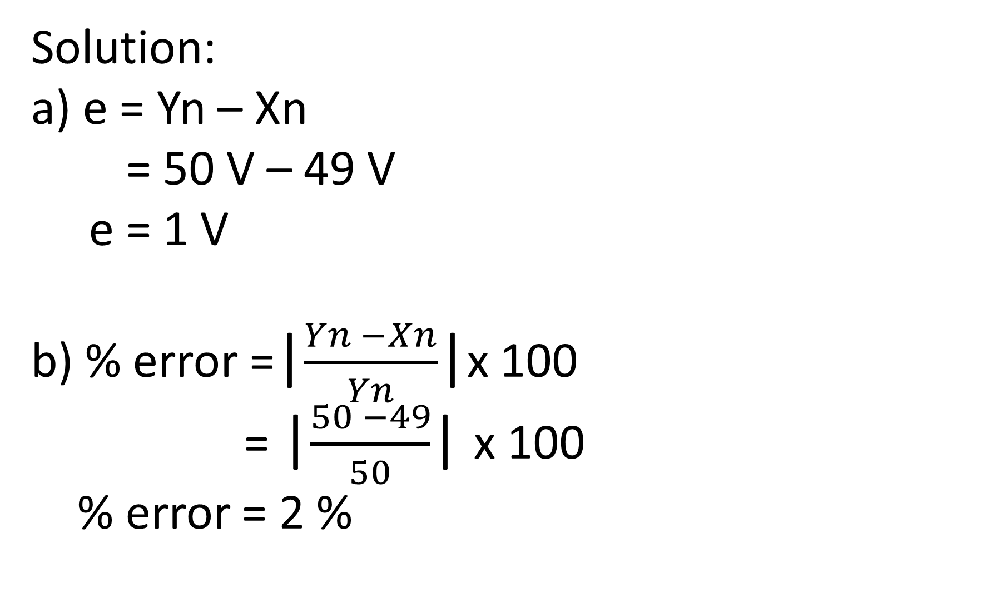
Solution:
a) e = Yn – Xn
= 50 V – 49 V
e = 1 V
b) % error =|$\frac{Yn −Xn}{Yn}$|x 100
= |$\frac{50 −49}{50}$| x 100
% error = 2 %

Slide 31

Solution:
c) A = 1 - |$\frac{Yn −Xn}{Yn}$|= 1 - |$\frac{50 −49}{50}$|
A = 1 - |$\frac{1}{50}$|
A= 0.98
d) a = 100% - % error
a = 100% - 2%
a = 98%

Slide 32
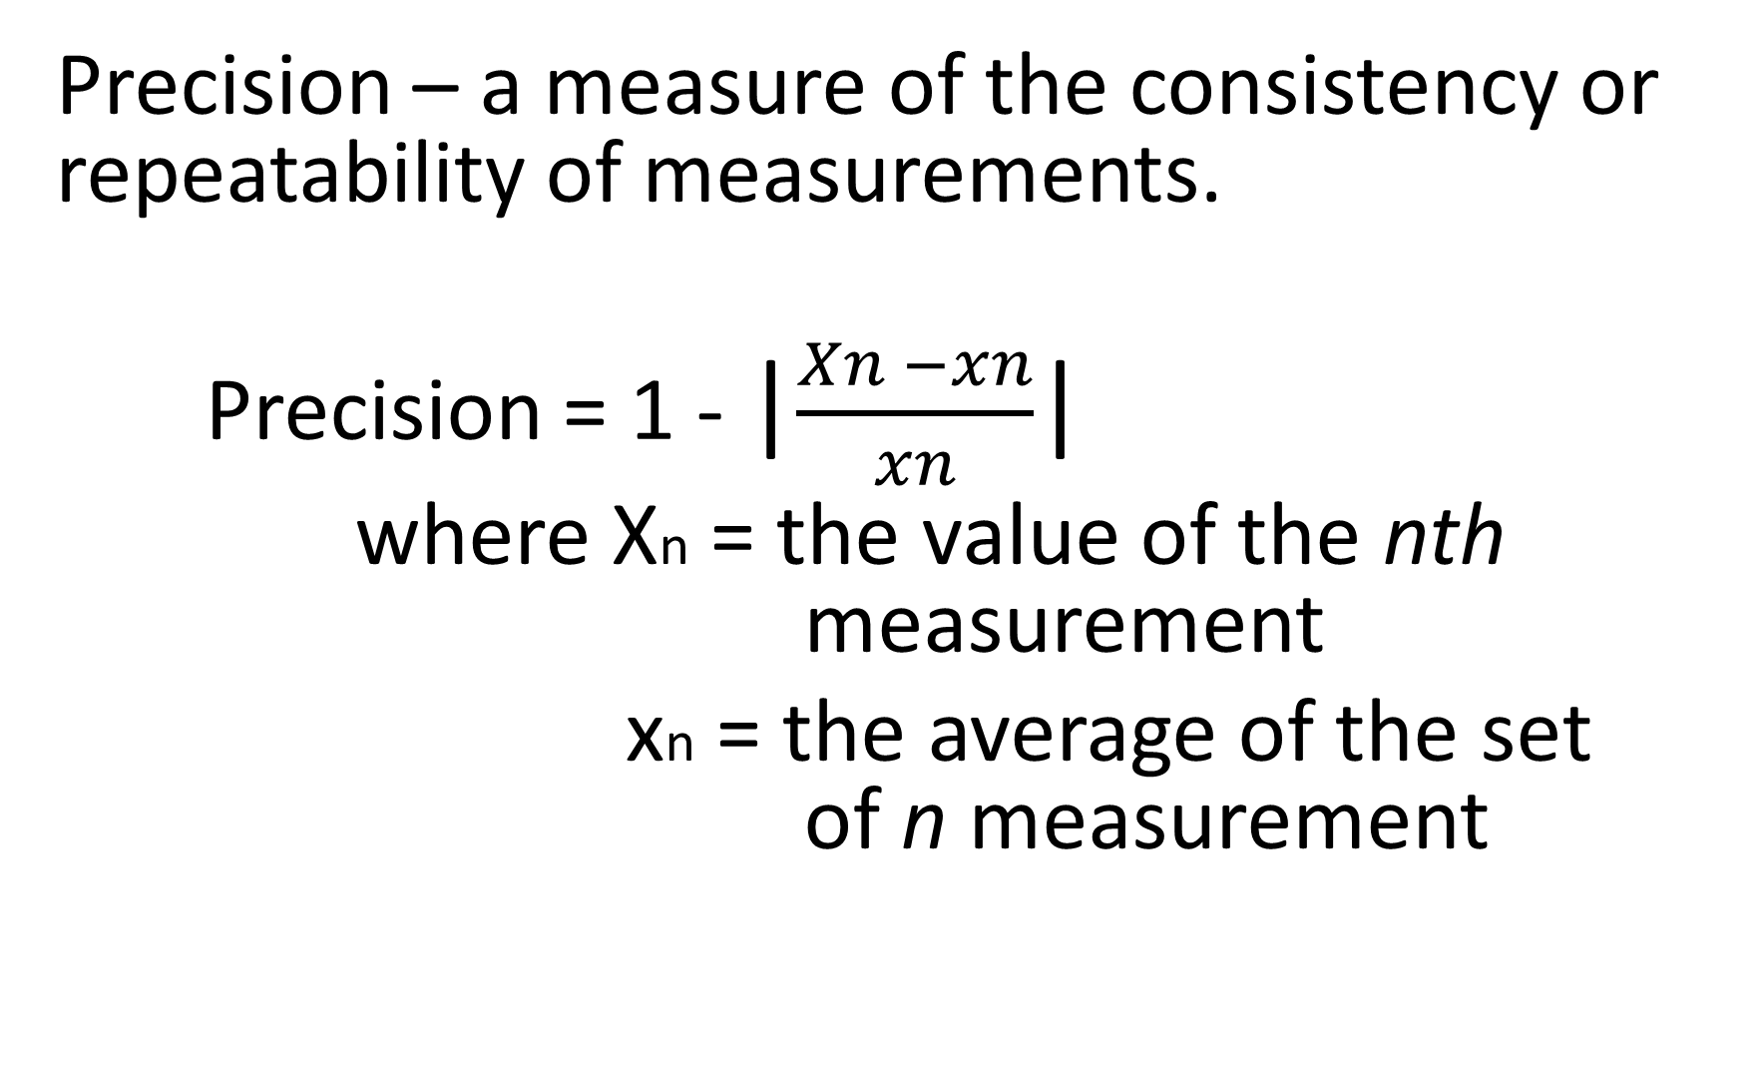
Precision – a measure of the consistency or repeatability of measurements.
Precision = 1 - |$\frac{Xn −xn}{xn}$|
where Xn = the value of the nth measurement
xn = the average of the set of n measurement

Slide 33

Basic Instrument System
Most modern analog equipment works on the following standard signal ranges:
Electric – 4 mA to 20 mA
Pneumatic – 0.2 bar to 1.0 bar
Older electrical equipment uses 0 to 10 V.

Slide 34
Basic Instrument System
As of now, the instruments are digital with a binary digital encoder built in to give a binary digital output.
Pneumatic signals are commonly used in process industries for safety especially when there is a risk of fire or explosion.

Slide 35
Things that are commonly measured:
Temperature Pressure
Speed Flow rate
Force Movement, Velocity and Acceleration
Stress and Strain Level or Depth
Mass or Weight Density
Size or Volume Acidity/Alkalinity

Slide 36
Sensors may operate simple on/off switches to detect the following:
Objects (Proximity switch)
Empty or full (level switch)
Hot or cold (thermostat)
Pressure high or low (pressure switch)

Slide 37
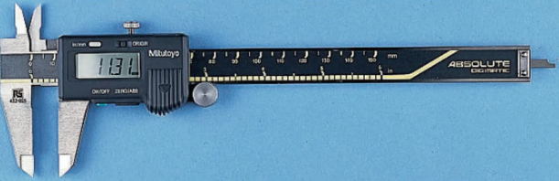
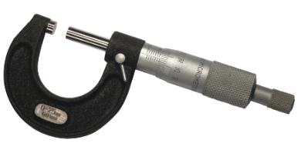
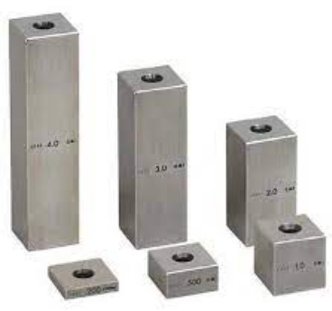


Slide 38
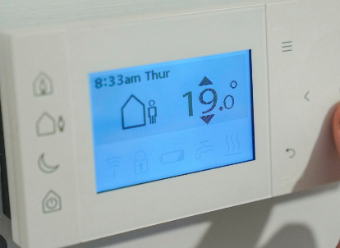
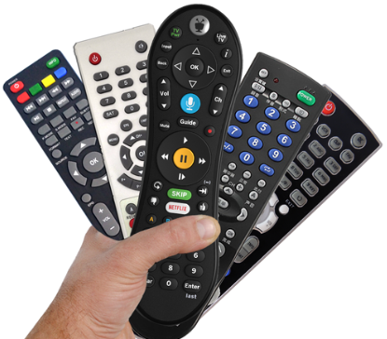
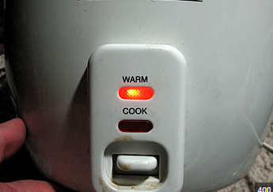

Slide 39
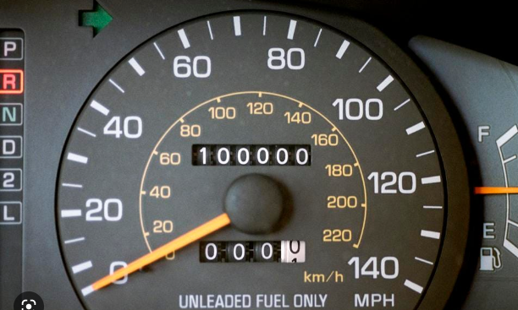


Slide 40
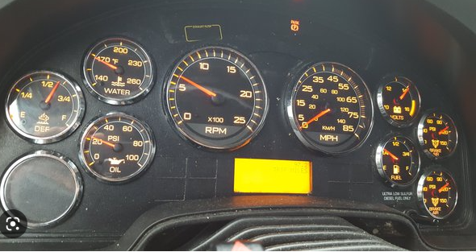

Slide 41
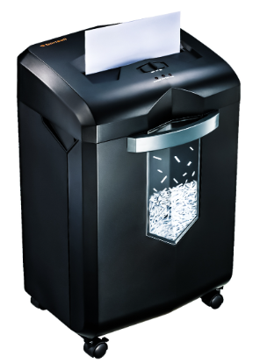

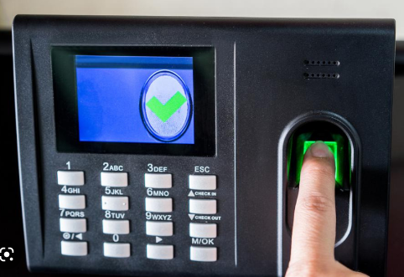

Slide 42

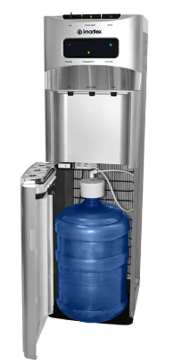
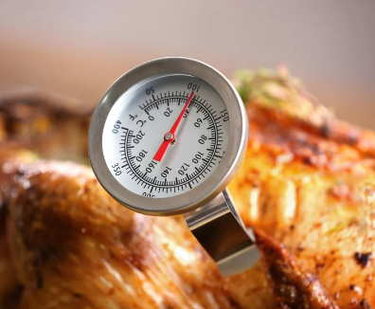
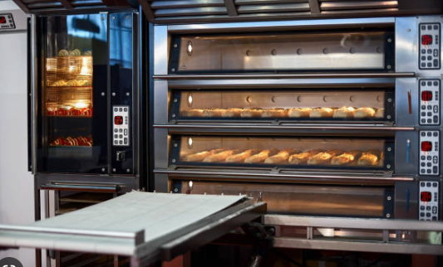
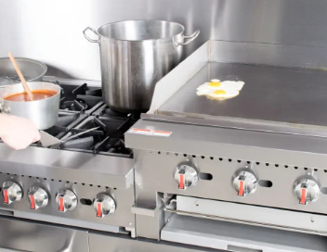

Slide 43
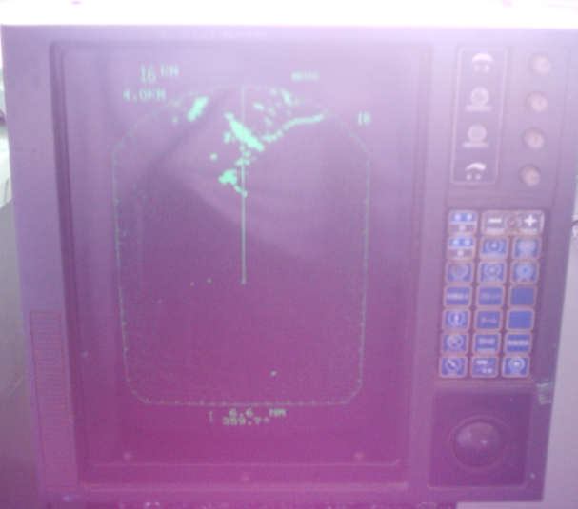
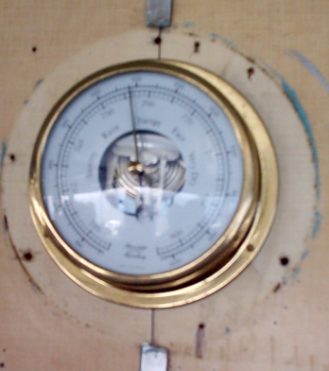

Slide 44
